Slide 1
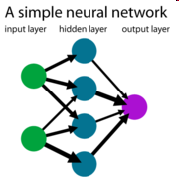
Introduction to Artificial Neural Networks

Slide 2
Neural Network
Massively parallel in nature
Perform fast computations
Can mimic human brain
Network with high number of interconnections
Very complex

Slide 3
Biological Motivation
Human brain is a densely interconnected network of approximately 10¹¹ neurons, each connected to, on average, 10⁴ others.
Neuron activity is excited or inhibited through connections to other neurons.
The fastest neuron switching times are known to be on the order of 10⁻³ sec.

Slide 4
Structure of Biological Neuron
The neuron is a complex biochemical and electrical signal processing processing unit that receives and combines signals from many other neurons through filamentary input paths, the dendrites.
Components of biological neuron :
Dendrites – are bunched into highly complex dendrites trees (tree links). collects input from other neurons
Axon – the output area of the neuron is a long fiber called axon.
Soma – cell body. It sums the incoming signals
Synapse – the connecting point between a neuron axon and another neuron’s dendrite is called a synapse

Slide 5
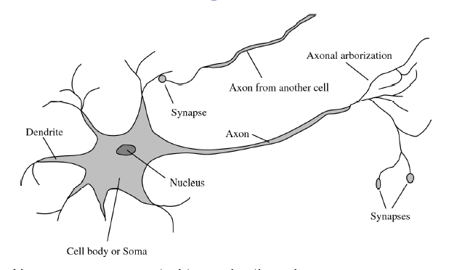
Communication of two neurons

Slide 6
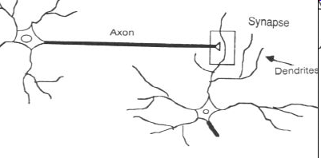

Slide 7
How the brain works
Each neuron receives inputs from other neurons
Some neurons also connect to receptors
Neurons use spikes to communicate
The timing of spikes is important
The effect of each input line on the neuron is controlled by a synaptic weight
The weights can be positive or negative
The synaptic weights adapt so that the whole network learns to perform useful computations
Recognizing objects, understanding language, making plans, controlling the body

Slide 8
Features/Specification of Brain
Number of neurons 10 billion
Number of interconnections 60 trillions
Total number of synapses 100,000 billion
Operation /sec/neuron 100
Total number of operations 10,000 trillion/sec
Human brain volume 300cm³
Human brain weight 1.5 kg
Power dissipation per neuron 25 * 10⁻¹⁰ W

Slide 9
Biological Neural Nets
Pigeons as art experts (Watanabe et al. 1995)
Experiment:
Pigeon in Skinner box
Present paintings of two different artists
Reward for pecking when presented a particular artist

Slide 10
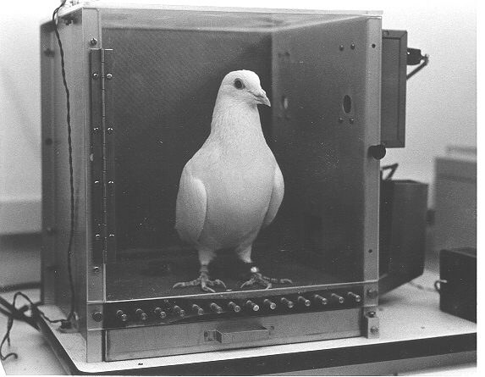

Slide 11
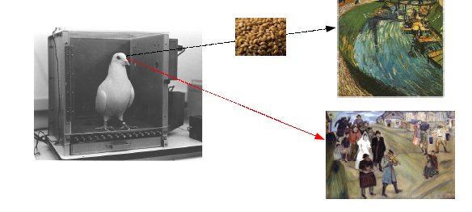

Slide 12
Pigeons were able to discriminate between two artists with 95% accuracy (when presented with pictures they had been trained on)
Discrimination still 85% successful for previously unseen paintings of the artists
Pigeons do not simply memorise the pictures
They can extract and recognise patterns (the ‘style’)
They generalise from the already seen to make predictions
This is what neural networks (biological and artificial) are good at prediction (unlike conventional computer)

Slide 13
Concept of Neural Network
A NN is a machine learning approach inspired by the way in which the brain performs a particular learning task:
Knowledge about the learning task is given in the form of examples.
Inter neuron connection strengths (weights) are used to store the acquired information (the training examples).
During the learning process the weights are modified in order to model the particular learning task correctly on the training examples.

Slide 14
History of Neural Network
The first artificial neuron was produced in 1943 by the neurophysiologist Warren McCulloch and the logician Walter Pits. But the technology available at that time did not allow them to do too much.
1949 first learning rule
1969 Minsky & Papert perceptron
Limitation – death of ANN
1980’s Re-emergence of ANN – Multilayer network

Slide 15
Neural Network - Paradigm
Inspired by parallel architecture of Animal Brain
Neural network are a form of multiprocessor computer system
simple processing elements
high degree of interconnection
simple scalar messages
adaptive interaction between elements

Slide 16
Conventional computer Vs Neural Network
Conventional computer
Neural Network
processing is sequential--one task
computers function logically with a set of rules and calculations
traditional computers have to learn by rules
programmable by higher level languages like C or Java and then translating that down to the machine's assembly language
conventional computers must learn only by doing different sequences or steps in an algorithm
its ability to do many things at once
artificial neural networks can function via images, pictures, and concepts.
artificial neural networks learn by example
artificial neural networks can "program themselves."
neural networks are continuously adaptable by truly altering their own programming

Slide 17
Why Neural Network
Neural networks, with their remarkable ability to derive meaning from complicated or imprecise data, can be used to extract patterns and detect trends that are too complex to be noticed by either humans or other computer techniques.
A trained neural network can be thought of as an "expert" in the category of information it has been given to analyze. This expert can then be used to provide projections given new situations of interest and answer "what if" questions.

Slide 18
Books
Principles of Soft computing, Sivanandam, Wiley-India
Principles of Soft computing , S.N Sivanandam, S.N Deepa
3. Introduction to Artificial Neural Networks, S.N Sivanandam, M Paulraj
4. Neural Networks, Fuzzy Logic and Genetic Algorithms, Rajasekaran
5.Artificial Neural Networks: An Introduction, Priddy, Keller
6.Understanding Neural Networks and Fuzzy Logic, Kartalopoulos

